Slide 1
Test Inputs
We are using our approximate string matching codes for detecting special genes in long strings of chromosomes.
Results are collected by measuring the time of our codes for detecting the gene that represents the size of the head of humans in their first Chromosomes!

Slide 2
Test Strategy
We test three different sequential algorithms.
Each for 10 different text sizes, from 7 Kilo to 70 Kilo string lengths.
We test each case with different numbers of mismatches allowed to check the its effect on the performance of the algorithms.

Slide 3
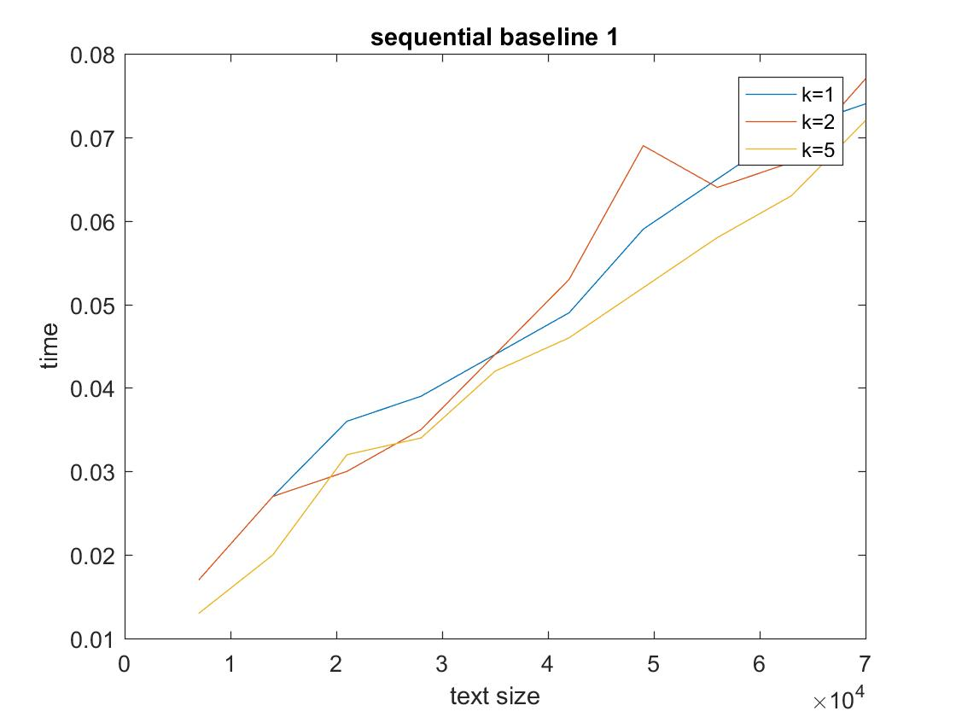
Results of Sequential Algorithms

Slide 4
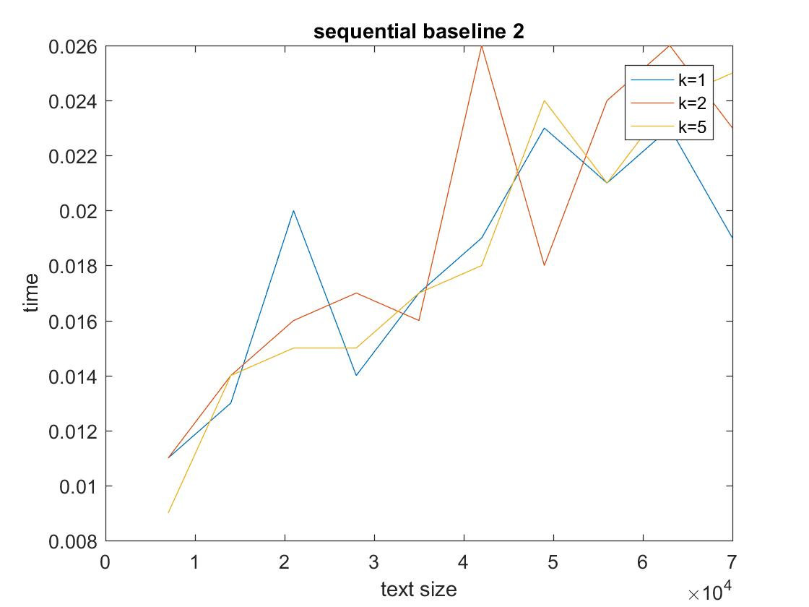
Results of Sequential Algorithms

Slide 5
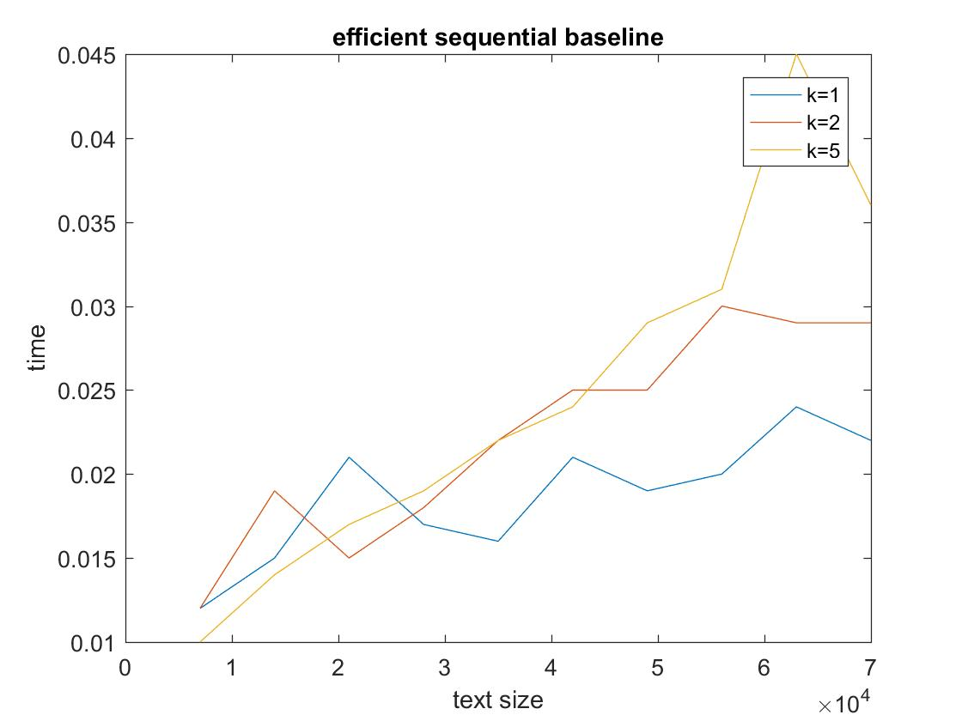
Results in Sequential Algorithms

Slide 6
Comparison of Sequential Algorithms
Given n=text length m=pattern length k= number of mismatches
Baseline 1 is the slowest.
Baseline 1 and baseline 2 do not show special patterns of execution time when we increase k.
Their complexity: O(mn)
Efficient code’s timing show that with different k, we have significantly different execution time.
Its complexity: O(nk)

